Slide 1
Leveraged ETF Arbitrage : the case of SPY -TQQQ
Author: Zeyao Li, Zixiao Min, Kaiwen (Kevin) Shen,
Yufei (Carl) Yang, Hang (Brian) Zhao

Slide 2
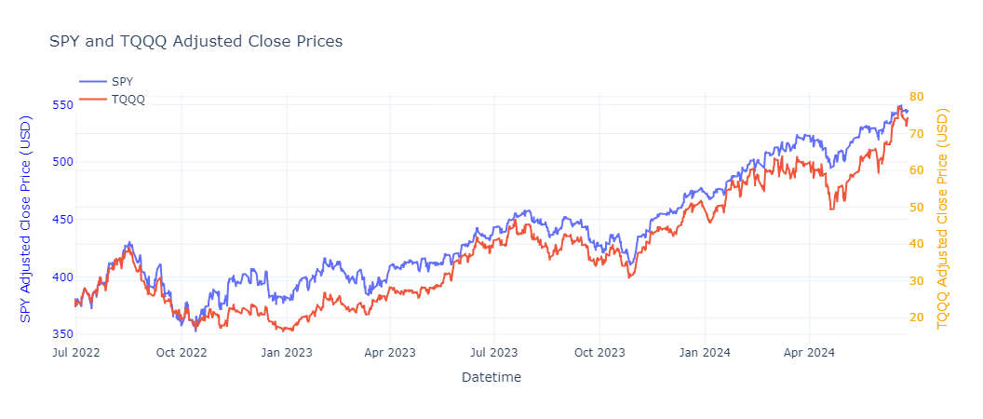
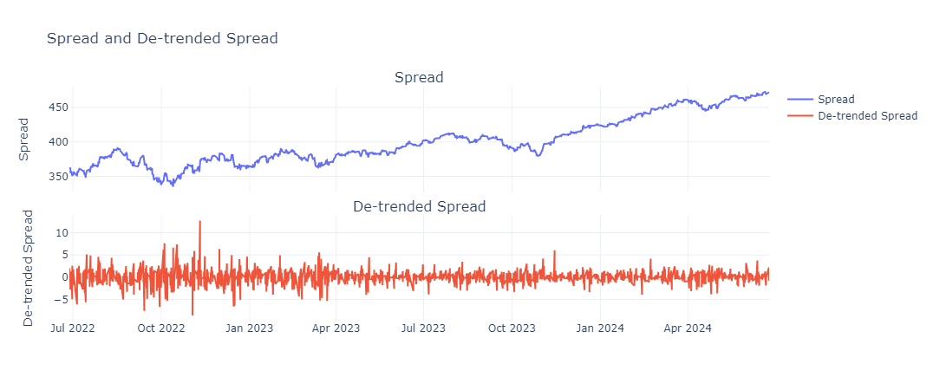
SPY and TQQQ Dynamics

Slide 3
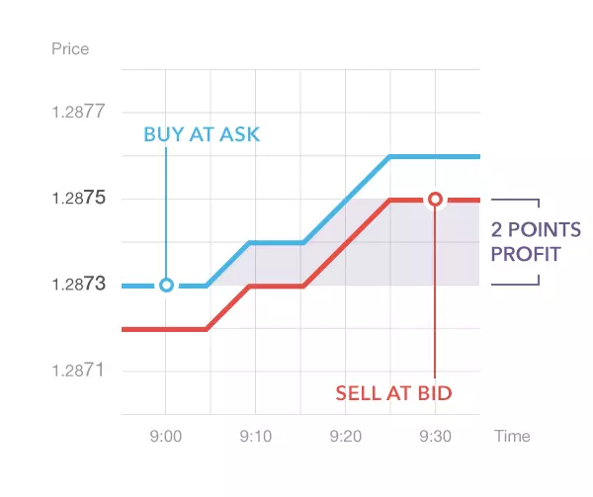
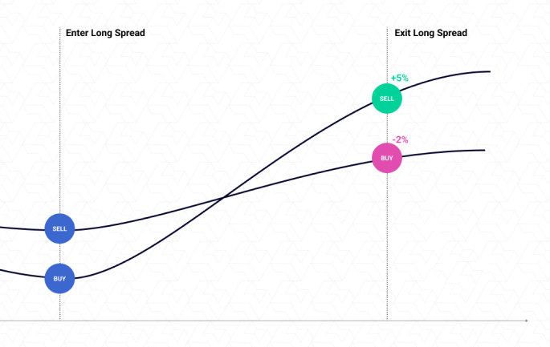
Trading strategy:
Overall strategy
Every trade we make:

Slide 4
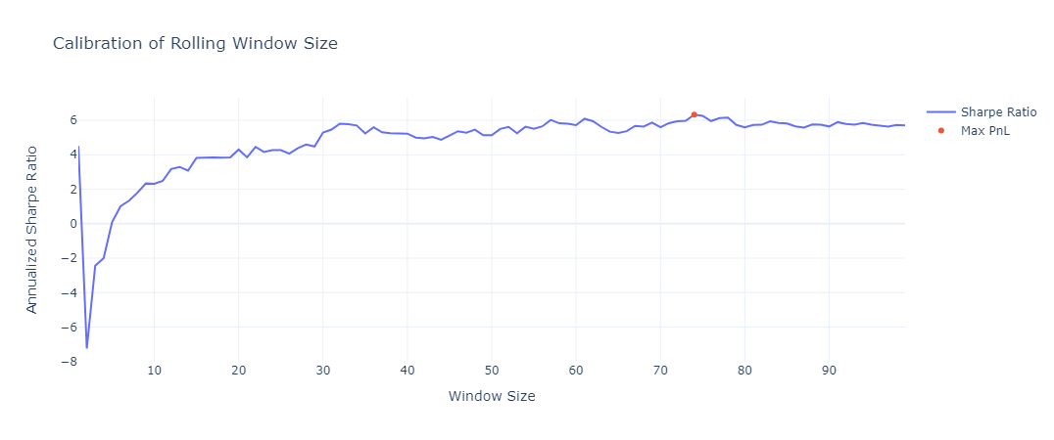
Lookback Period Tuning

Slide 5
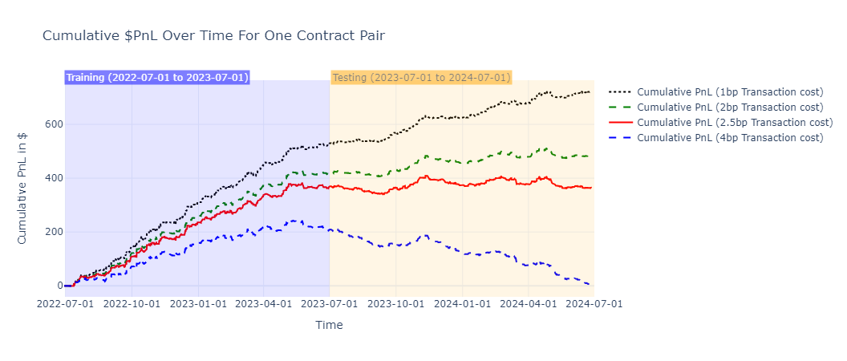
Result

Slide 6
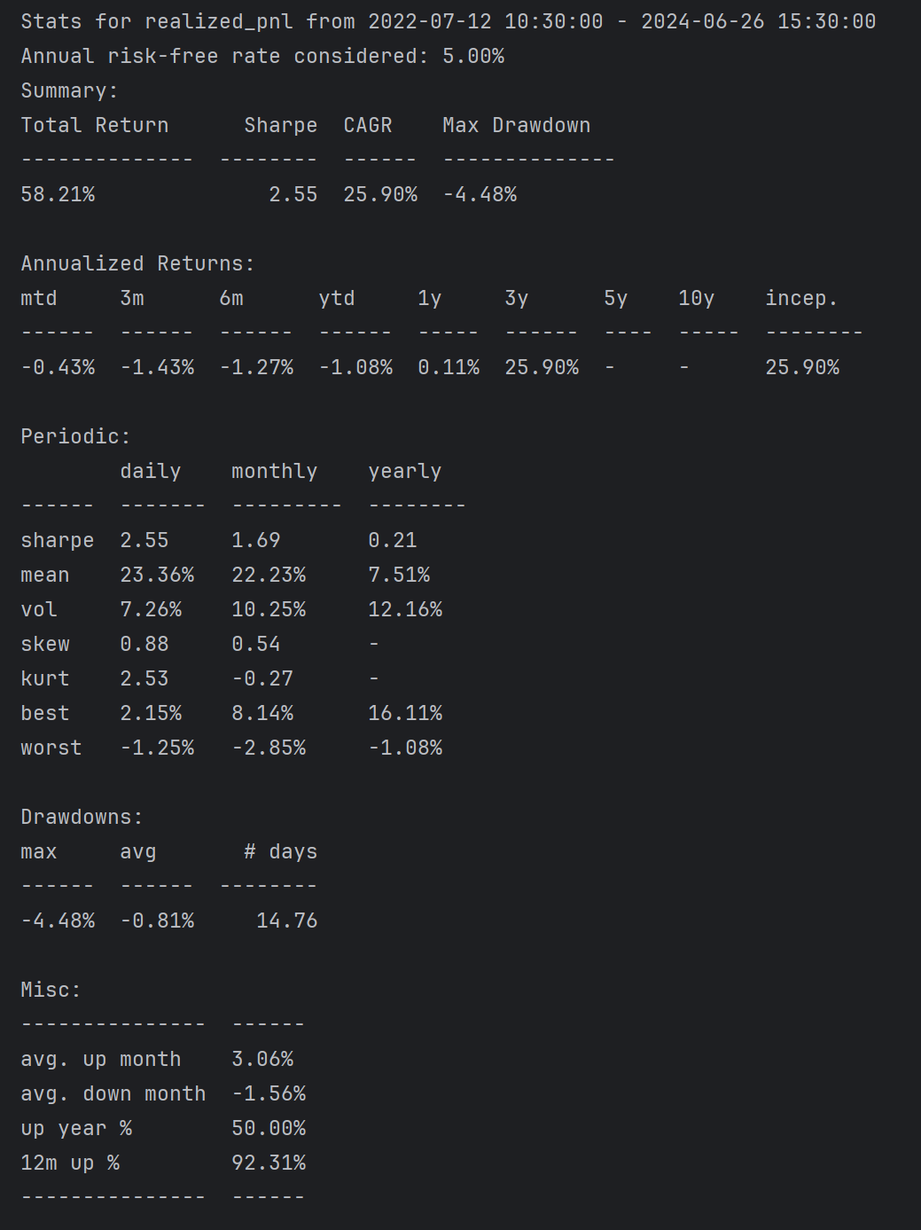
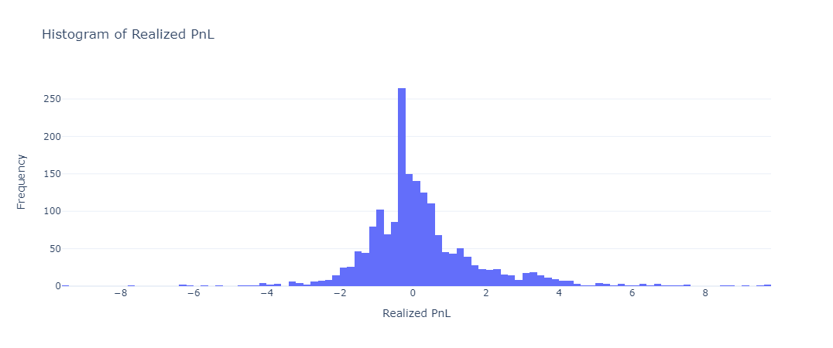
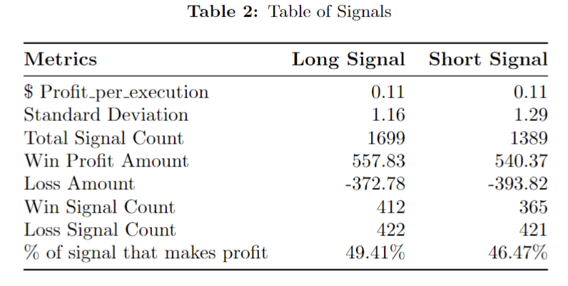
Realized PnL

Slide 7
Appendix: Strategy capacity estimation
Rough estimation of 1.5bp * Price/vol in min(SPY, TQQQ)=4306 contract pairs
Multiply by initial capital of 626, result in roughly 2.6 million USD
Assumption:
BBO price can take 4306 units
Enter and exit position instantaneously
No extreme event.

